Slide 1

Simulation of blood flow in multi-layered arterial model using CFD

Slide 2
Contents
Sl No. | Contents | Slide No.
1. | Introduction | 4
2. | Problem Statement & Objectives | 5
3. | Motivation & Background | 6
4. | Literature Survey | 7-12
5. | Flow Chart | 13
6. | Methodology / Simulation Workflow | 14
7. | Module Testing & Intermediate Analysis | 15
8. | Materials | 16
9. | Intermediate Results | 17
10. | Simulation Work Flow | 18
11. | Strain Analysis – Diastolic | 19

Slide 3
Contents
Sl No. | Contents | Slide No.
12. | Strain Analysis - Systolic | 20
13. | Result | 21,22
14. | Conclusion | 23
15. | Future Scope | 24

Slide 4
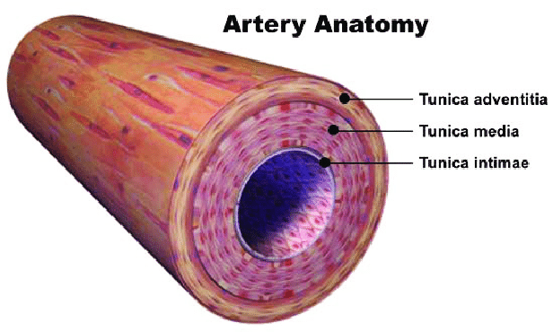
Introduction
CAD (Coronary Artery Disease) is a major global health issue due to artery narrowing.
Realistic modeling of arterial blood flow helps in analyzing disease risk factors.
This project uses Computational Fluid Dynamics (CFD) to simulate blood flow in a 3-layered artery using COMSOL.
Three-Layered Artery Structure:
Tunica Intima: Smooth inner lining to reduce friction.
Tunica Media: Muscle and elastic fibers for vessel movement.
Tunica Adventitia: Outer connective layer for support.

Slide 5
Problem Statement
Simulation of blood flow in multi-layered arterial model using CFD.
Objectives
Develop a multilayered 3-Dimensional arterial structure.
Incorporate realistic material properties for the media, adventitia, and intima layers using advanced mathematical models and incorporate hyperelastic behavior.
Capture nonlinear stiffening and anisotropic behavior to resemble a real non uniform artery.
Analyze velocity profiles, pressure gradients, and wall shear stress under physiological conditions.

Slide 6
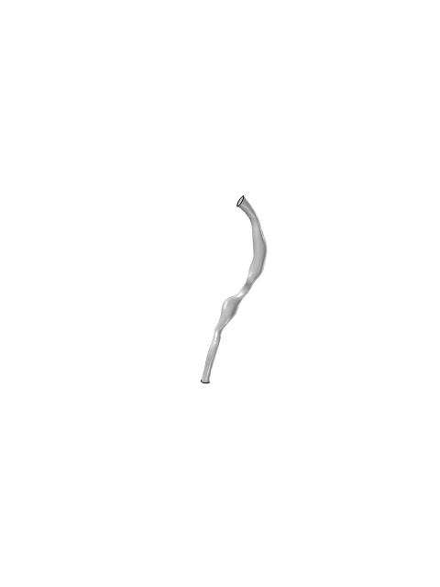
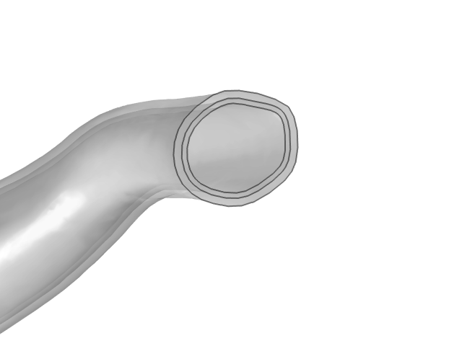
Motivation & Background
Improvement from Single-Layer Model: Addresses oversimplified arterial dynamics
Layer Differentiation: Models intima, media, and adventitia with distinct properties.
Three-Layer Approach: Enhances blood flow simulation and hemodynamic accuracy.
HGO Framework Implementation: Captures nonlinear stiffening and anisotropy.
Fiber Orientation Integration: Simulates directional stiffness for realism.
CFD Simulations: Analyzes velocity, pressure, and wall shear stress effectively.
Single layered artery model
Three Layered artery model

Slide 7
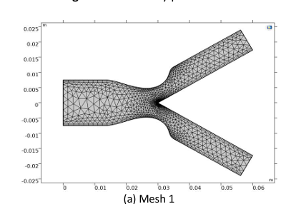
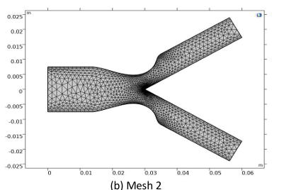
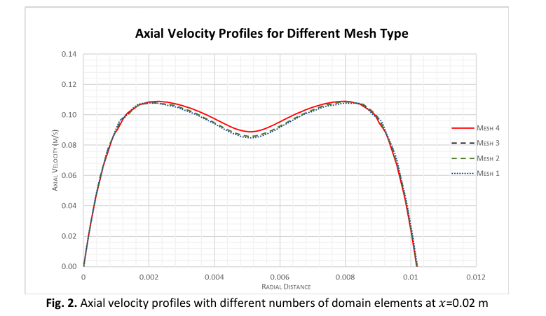
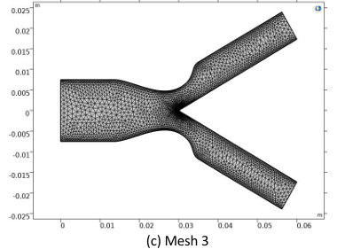
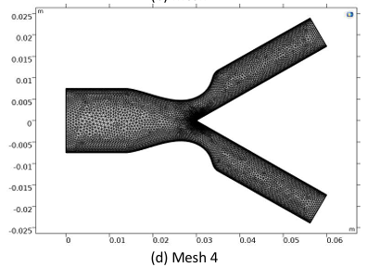
Literature Survey
Numerical Computation of Blood Flow and Mass Transport in Stenosed Bifurcated Artery
Kannigah Thirunanasambantham, Zuhaila Ismail, Lim Yeou Jiann, Amnani Shamjuddin
Journal of Advanced Research in Fluid Mechanics and Thermal Sciences Volume 110, Issue 2 (2023) 79-94
Introduction :
Coronary Artery Disease (CAD): Leading cause of mortality due to atherosclerosis.
Stenosis Impact: Narrows arteries, alters hemodynamics, and increases cardiovascular risks.
Study Approach: Uses COMSOL Multiphysics (FEM) to simulate blood flow in a stenosed bifurcated artery.
Blood Model: Non-Newtonian Carreau fluid to account for shear-thinning properties.
Key Analysis: Examines velocity distribution, mass concentration, and recirculation effects.
Objective: Assess stenosis severity and Reynolds number effects on hemodynamics.
Results :
Velocity Profiles
Velocity increased as Reynolds number increased.
Higher stenosis severity (60%) caused a peak velocity in the narrowed region, leading to disturbed flow patterns.
Recirculation zones were observed downstream of stenosis, leading to turbulence.
Mass Concentration
Higher Reynolds numbers led to greater mass transport.
In severe stenosis (60%), mass concentration was higher, increasing the risk of plaque formation.
Recirculation zones showed higher solute accumulation, indicating atherosclerosis-prone areas.
Wall Shear Stress (WSS)
Shear stress increased significantly at stenosis sites, potentially leading to endothelial damage.
Bifurcation points showed high WSS, confirming their role in plaque development.
Methodology :
Computational Modeling
A 2D stenosed bifurcated artery model was created.
Artery assumed as a rigid wall with no-slip conditions.
Blood modeled as a non-Newtonian Carreau fluid.
Governing Equations
Continuity equation for mass conservation.
Momentum equations for blood flow behavior.
Mass transport equation (Fick’s Law) for solute concentration.
Simulation Setup
Solved using COMSOL Multiphysics 5.2 (FEM).
Simulations for Reynolds numbers: Re = 300, 500
Simulations for stenosis severity: 20%, 40%, 60%.
Mesh refinement to ensure accuracy
6

Slide 8
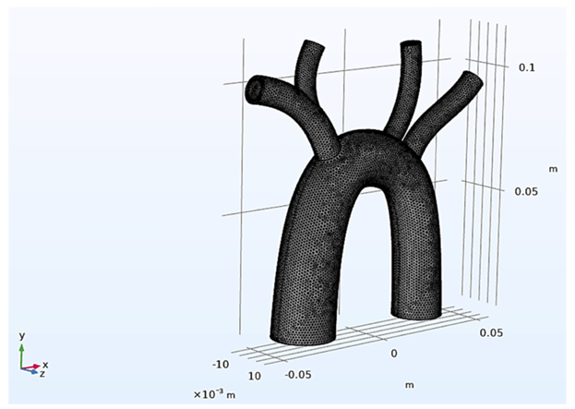
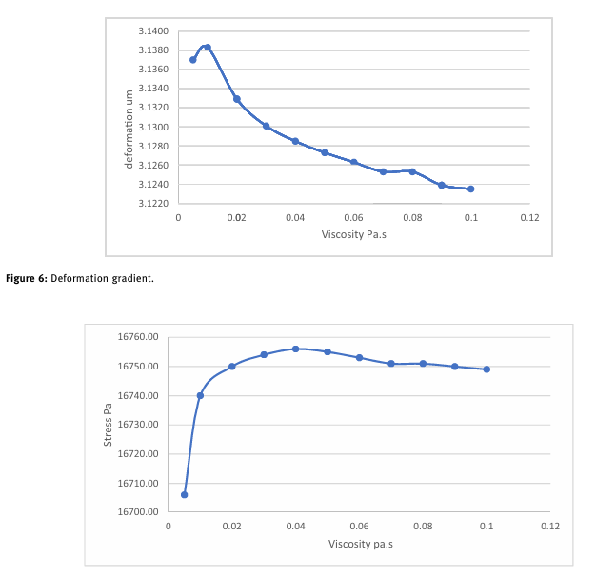
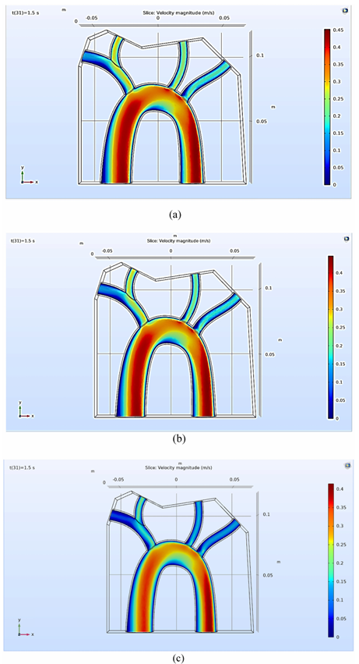
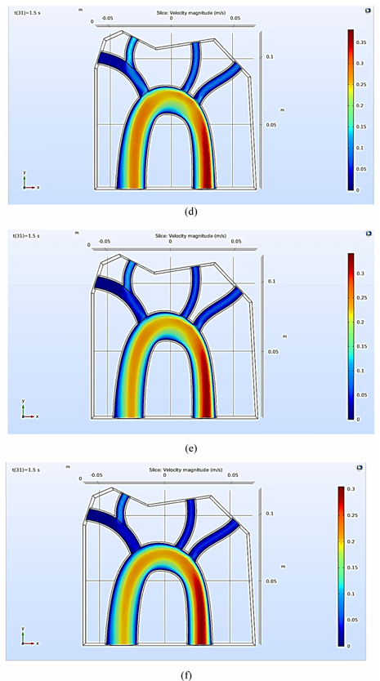
Literature Survey
Multiphysics analysis for fluid–structure interaction of blood biological flow inside three-dimensional artery
Natiq Abbas Fadhil, Karrar A. Hammoodi, Lina Jassim, Hasan A. Al-Asadi, and Laith Jaafer Habeeb
Curved and Layered Structures 2023; 10: 20220187
Introduction
Blood is a liquid with mechanical properties, and arteries have structural mechanics that influence their behavior.
Smoking increases blood viscosity, affecting velocity, pressure, and arterial deformation.
The study focuses on fluid-structure interaction (FSI) in the aorta, analyzing how viscosity changes blood flow characteristics.
Uses COMSOL Multiphysics to solve kinetic equations and analyze blood-artery interactions.
Investigates the impact of viscoelasticity on arterial deformation and stress distribution.
Results :
Higher blood viscosity reduces velocity, increasing arterial stress.
Increased viscosity leads to higher pressure at the carotid artery, restricting blood flow.
Arterial deformation decreases with increasing viscosity, indicating stiffness.
The model confirmed recirculation zones that could contribute to plaque formation.
Methodology :
Computational Modeling
A 3D aorta model was designed using SolidWorks and imported into COMSOL Multiphysics.
The finite element method (FEM) was used to solve equations.
Variable viscosity levels were tested to assess their effect on blood flow and artery behavior.
Governing Equations
Navier-Stokes equations for incompressible, viscous fluid motion.
Continuity equation for mass conservation.
Stress-strain equations for arterial deformation analysis (FSI model).
Simulation Setup
The inlet velocity profile was set to mimic pulsatile blood flow.
Boundary conditions:
Inlet pressure = 126.09 mmHg.
Time step = 0.005 s over 1.5 s simulation period.
Mesh convergence analysis was conducted to ensure accuracy.
6

Slide 9
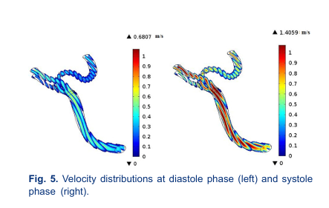
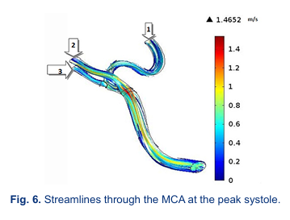
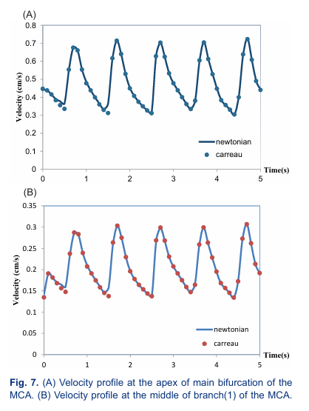
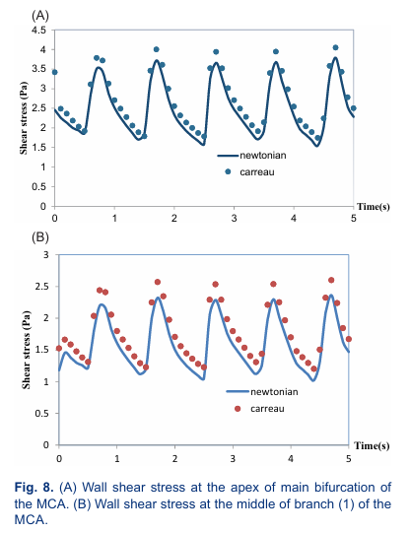
Literature Survey
Numerical investigation of the blood flow through the middle cerebral artery
Seyed Esmail Razavi, Vahid Farhangmehr, Nafiseh Zendeali
BioImpacts, 2018, 8(3), 195-200
Introduction
Stroke is the second leading cause of death globally (WHO report, 2012).
Ischemic stroke, caused by blood clots or stenosis, mainly affects middle cerebral arteries (MCAs).
This study uses Computational Fluid Dynamics (CFD) simulations to analyze blood flow in MCA.
Newtonian vs. Non-Newtonian models were compared for realistic blood flow representation.
Results :
Newtonian and non-Newtonian models showed minimal difference, making the Newtonian assumption valid for MCA.
The most vulnerable region for atherosclerosis was found at the highest curvature of MCA branches.
Velocity peaks occurred at stenotic regions, altering flow dynamics and potentially increasing stroke risk.
Methodology :
Computational Modeling
A 3D MCA model was created using CT angiography data from a 75-year-old man.
Blood was assumed to be laminar, incompressible, and unsteady.
Used COMSOL Multiphysics 5.2 with Galerkin's finite element method (FEM).
Governing Equations
Continuity equation for mass conservation.
Navier-Stokes equations for momentum conservation.
Carreau-Yasuda model was applied for non-Newtonian viscosity effects.
Simulation Setup
Unstructured tetrahedral meshing was used for high accuracy.
Simulated pulsatile blood flow with inlet velocity from Doppler ultrasound tests.
Constant pressure = 1440 Pa at the outlet with no-slip boundary conditions.
8

Slide 10
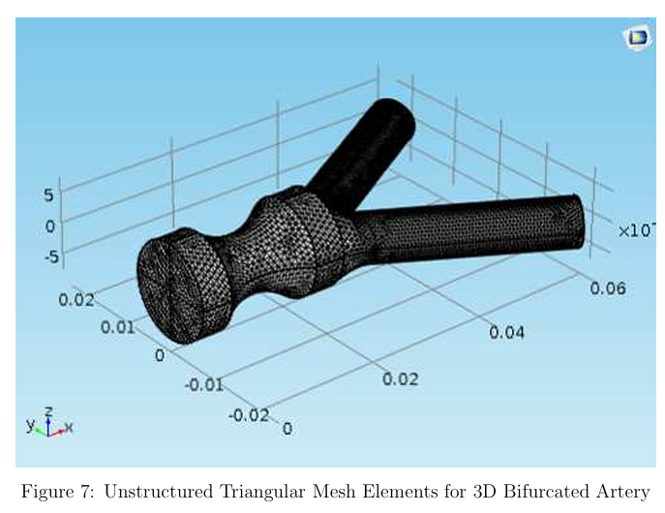
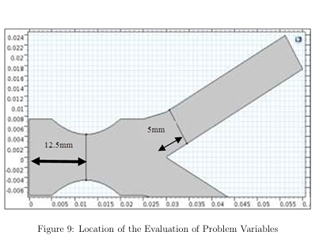
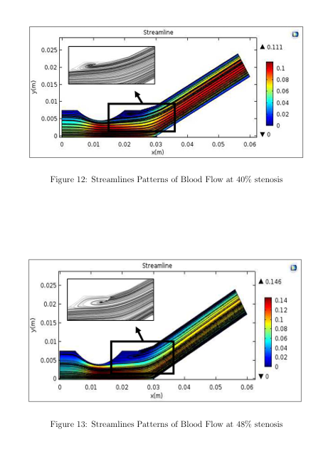
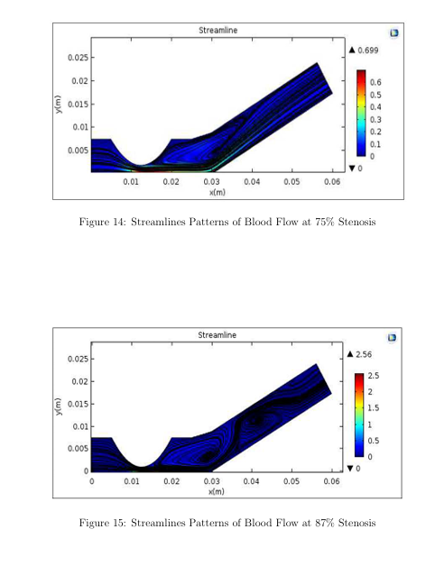
Literature Survey
3D Model of Generalized Power Law Blood Flow in a Stenosed Bifurcated Artery
Azim Azahari, Zuhaila Ismail and Normazni Abdullah
MATEMATIKA, 2018, Volume 34, Number 1, 87–102
Introduction
Atherosclerosis leads to stenosis, reducing blood flow and increasing cardiovascular risk.
Bifurcated arteries are particularly prone to plaque formation due to complex flow patterns.
This study simulates 3D blood flow in a stenosed bifurcated artery using the Generalized Power Law model.
The goal is to analyze velocity, recirculation zones, and shear stress variations.
Results :
Higher stenosis severity increased velocity fluctuations, affecting downstream blood supply.
Recirculation zones formed near bifurcation points, which may lead to atherosclerosis.
Low wall shear stress (WSS) regions correlated with plaque-prone areas.
Methodology :
Computational Modeling
A 3D bifurcated artery model was created based on a previous 2D study by Chakravarty & Mandal.
Blood flow was modeled as steady, incompressible, and non-Newtonian (Power Law model).
Governing Equations
Navier-Stokes equations for fluid motion.
Power Law model for non-Newtonian blood viscosity effects.
Simulation Setup
COMSOL Multiphysics 5.2 was used for finite element modeling (FEM).
Unstructured triangular meshing was applied for high resolution.
Inlet velocity = parabolic profile, ensuring fully developed flow conditions.
9

Slide 11
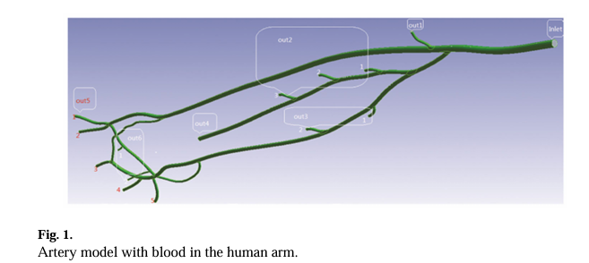
Literature Survey
SIMULATION ANALYSIS OF BLOOD FLOW IN ARTERIES OF THE HUMAN ARM
Wu Quanyu, Liu Xiaojie, Pan Lingjiao, Tao Weige, and Qian Chunqi
Biomed Eng (Singapore). 2017 August ; 29(4)
Introduction
Arm arteries play a crucial role in blood circulation, with ulnar and radial arteries being key blood suppliers.
The radial artery is historically important in traditional Chinese medicine.
This study uses Ansys Fluent to simulate blood flow in arm arteries, analyzing velocity, pressure, and shear stress.
Results :
Ulnar artery dominates blood supply over the radial artery.
High velocity in bifurcations, with peak velocity of 5.8 m/s in the radial collateral artery.
High shear stress in bifurcations, suggesting increased atherosclerosis risk.
Methodology :
Computational Modeling
3D model of human arm arteries created from MRI data.
Blood modeled using the Carreau fluid model to capture non-Newtonian behavior.
Governing Equations
Navier-Stokes equations for fluid flow.
Bird-Carreau model for non-Newtonian viscosity.
Simulation Setup
Inlet velocity = time-varying periodic function (heartbeat model, 75 bpm).
Mesh refinement with tetrahedral elements for accuracy.
Simulation performed using Ansys Fluent with PISO scheme.
10

Slide 12
Literature Survey
Limitation | Paper 1: Stenosed Bifurcated Artery | Paper 2: FSI in 3D Artery | Paper 3: MCA Blood Flow | Paper 4: Power Law in Bifurcated Artery | Paper 5: Blood Flow in Arm
Wall Assumption | Rigid walls | Rigid walls (FSI included) | Rigid walls | Rigid walls | Rigid walls
Flow Type | Steady-state | Pulsatile (simplified) | Unsteady (limited pulsatile) | Steady-state | Pulsatile (short duration)
Model Dimensionality | 2D | 3D | 3D | 3D | 3D
Non-Newtonian Effects | Carreau model (simplified) | Viscosity variation ignored | Newtonian & Non-Newtonian (minor difference) | Power Law model (not validated) | Carreau model (fixed viscosity)
Boundary Conditions | Fixed inlet velocity | Simplified outflow conditions | Fixed outlet pressure | Parabolic inlet (no pulsatile flow) | Zero-pressure outlets

Slide 13
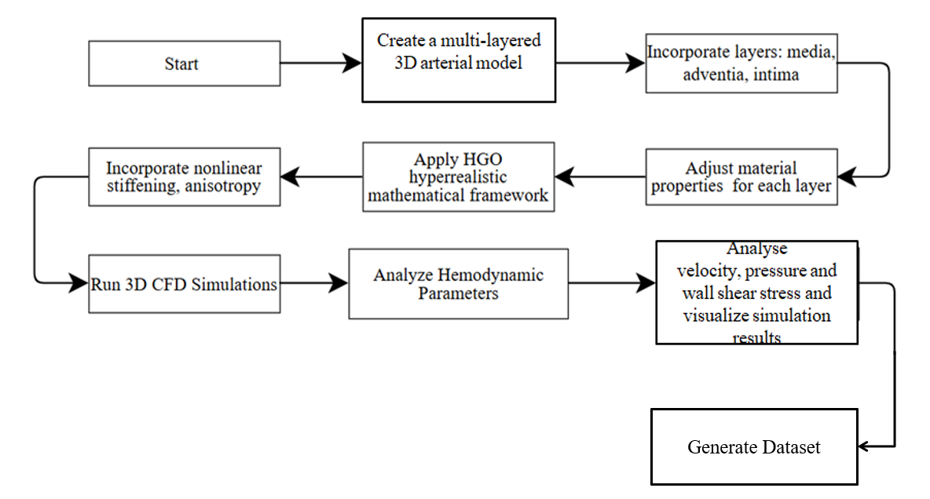
Flow Chart

Slide 14
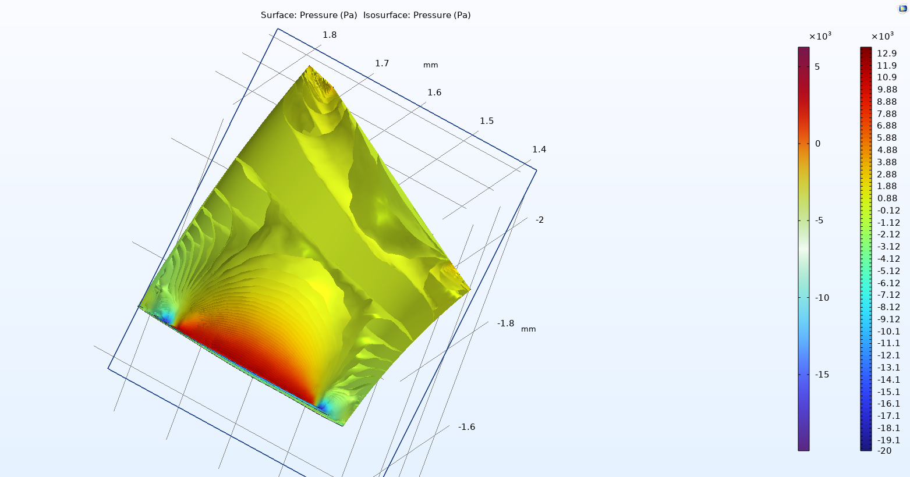
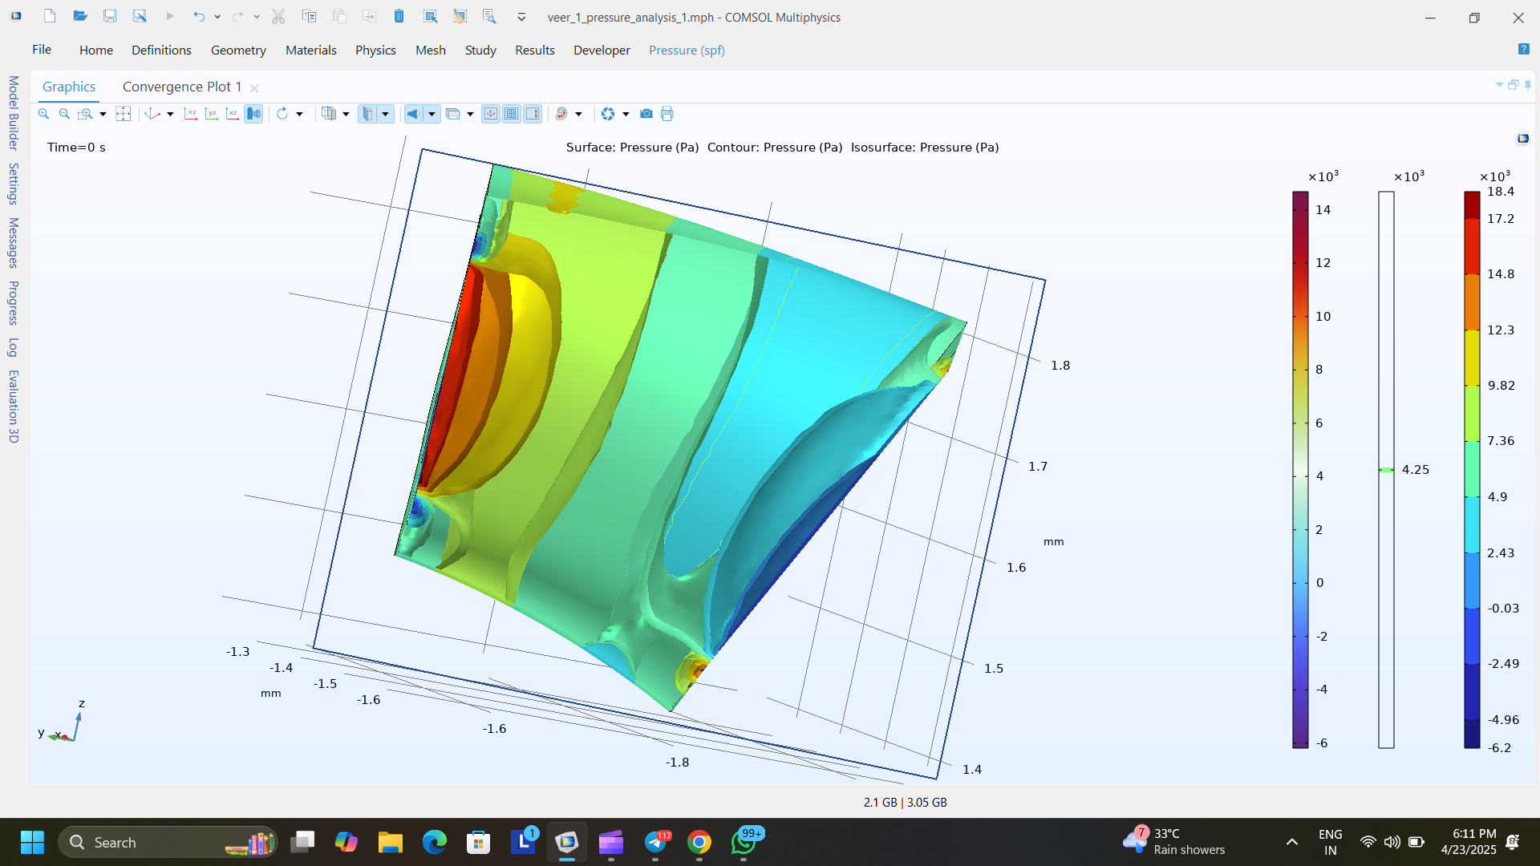
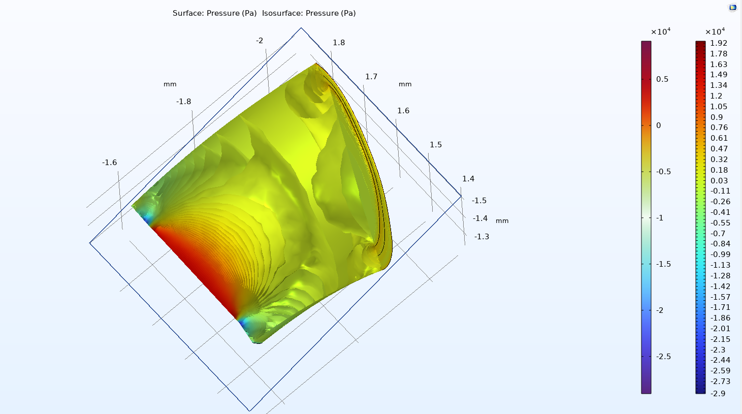
Methodology / Simulation Workflow
Input Data
3D artery geometry, layer properties, boundary conditions
Module 1: Preprocessing
Mesh generation, material assignment, setup of flow conditions
Module 2: Material and properties Applied
wall properties, blood flow parameters, layer segmentation
Module 3: Hemodynamic Analysis
Solve Navier-Stokes + FSI, simulate blood flow & wall deformation
Output
Velocity profiles
Pressure gradients
Initial Static Pressure: 11000 Pa
Initial Velocity: 1 m/s
Initial Static Pressure: 16000 Pa

Slide 15
Module Testing and Intermediate Analysis
Case | Initial Condition | Observation | Interpretation
Case 1 | Static Pressure = 11000 Pa | - High pressure at the inlet (red zone) - Gradual pressure drop downstream - Streamlines show curvature and flow behavior | Pressure propagates smoothly; useful for identifying early-stage flow development in the geometry
Case 2 | Velocity = 1 m/s | - Distinct pressure contours due to convective flow - Zones of pressure variation aligned with velocity gradients and geometry effects | Demonstrates how fluid momentum changes pressure distribution; validates model responsiveness to velocity
Case 3 | Static Pressure = 16000 Pa | - Larger red zones indicating higher pressure - Greater spatial spread of elevated pressure - Stronger gradients compared to 11000 Pa | Confirms that increasing pressure elevates internal stress; critical for material response and stability

Slide 16
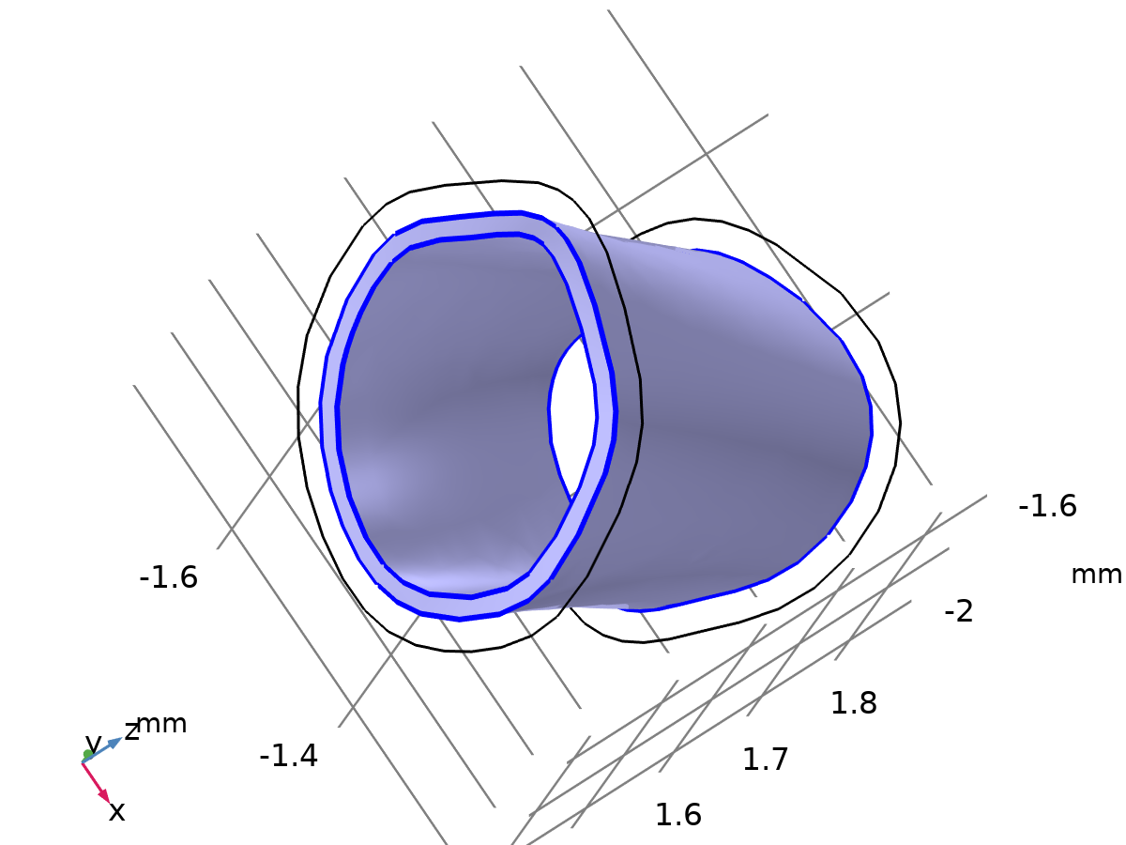
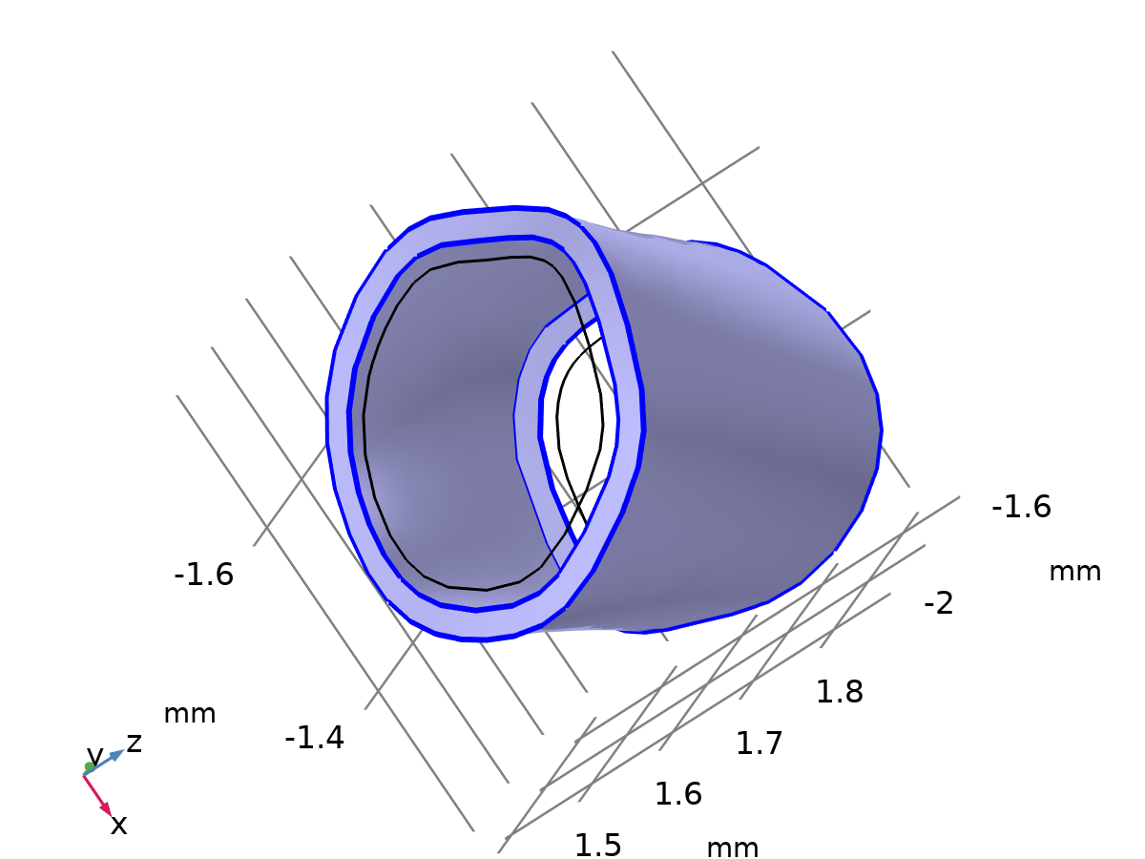
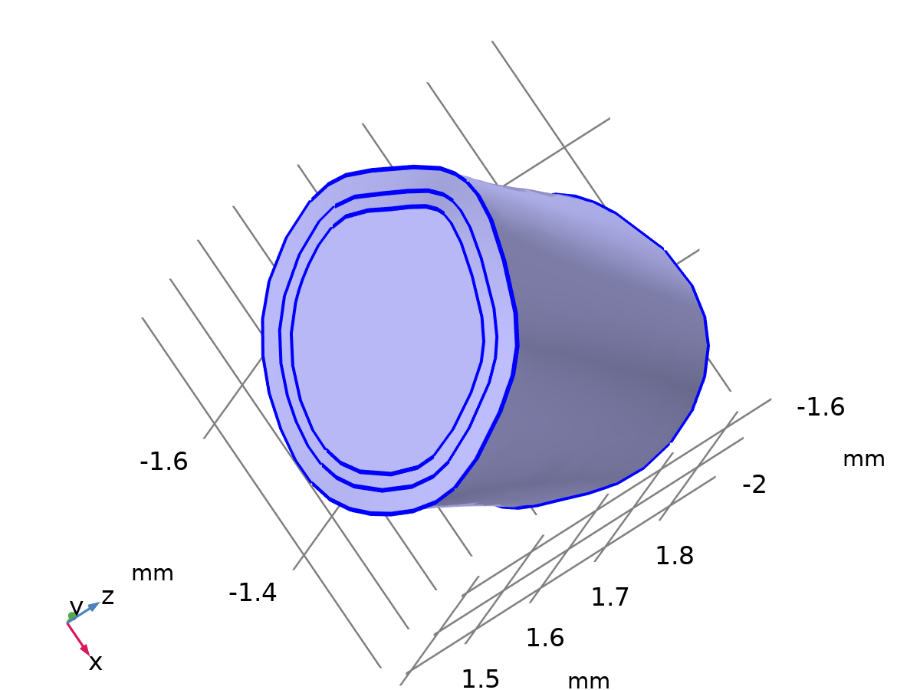
Materials
Blood Vessel(media)
Blood Vessel(Adventitia)
Blood
Holzapfel–Gasser–Ogden MODEL
Holzapfel–Gasser–Ogden MODEL
Description | Value | Unit
Fiber stiffness | 2500 | Pa
Model parameter | 75 | 1
Fiber dispersion | 0.05 | 1
Description | Value | Unit
Density | 1060 | kg/m³
Dynamic viscosity | 4E5 | Pa·s
Description | Value | Unit
Fiber stiffness | 5000 | Pa
Model parameter | 50 | 1
Fiber dispersion | 0.05 | 1
Source: Nonlinear Solid Mechanics: A Continuum Approach for Engineering
A New Constitutive Framework for Arterial Wall Mechanics and a Comparative Study of Material Models

Slide 17
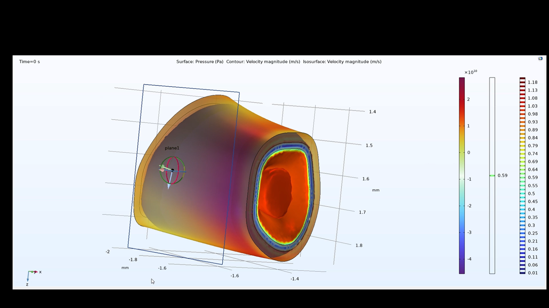
Intermediate Result
Pressure of the segmented artery

Slide 18
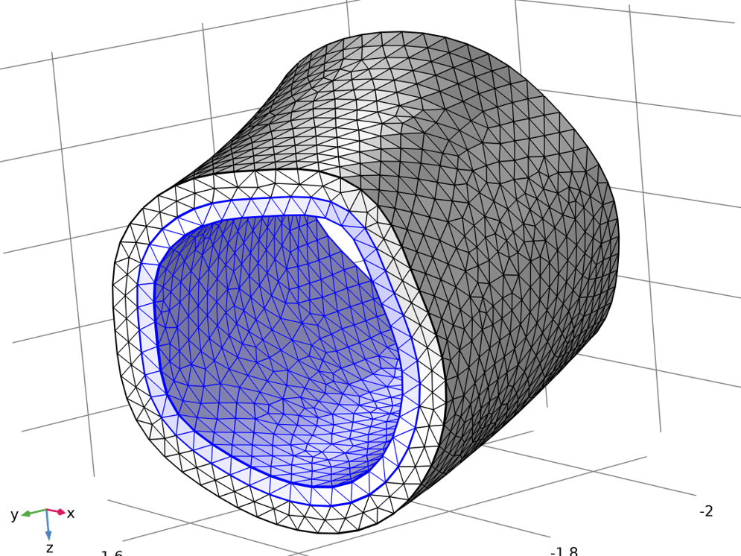
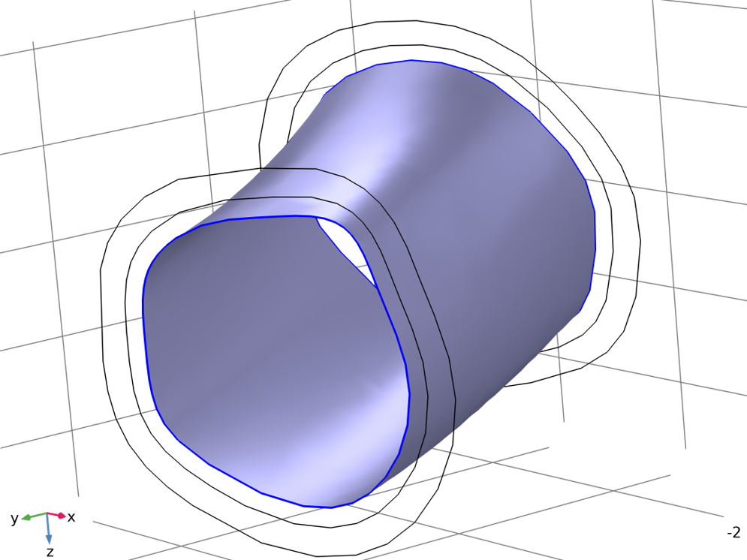
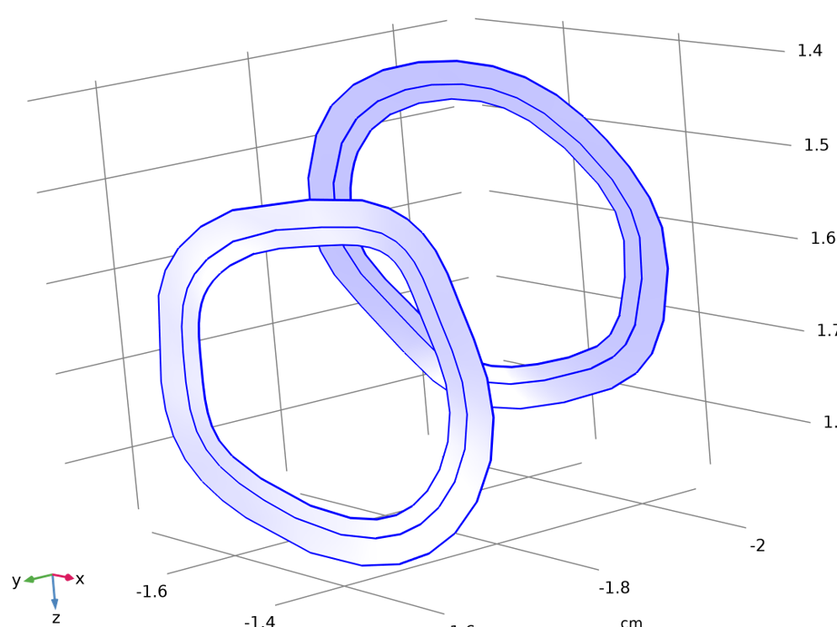
Simulation Workflow
Mesh statistics
Description | Value
Status | Complete mesh
Mesh vertices | 4418
Tetrahedral | 19540
Triangles | 6335
Edge elements | 287
Vertex elements | 16
Number of elements | 19540
Minimum element quality | 0.1866
Average element quality | 0.6992
Boundary load
Description | Value
Initial Displacement vectors | (0, 0, 0)m
Structural Velocity Filed | (0, 0, 0)m/s
Load type | Pressure
Pressure | 10,665.76Pa & 15,998.64Pa
Fixed Constraint
1 | Selection of walls that shouldn’t be affected by the pressure of the blood flowing inside the artery
2 | The walls do not experience any deformations but will experience pressure applied by other walls

Slide 19
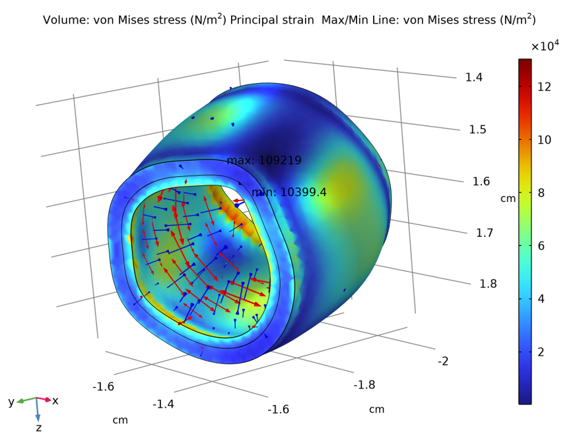
Strain Analysis – Diastolic
For Boundary Load: 10,665.76Pa
Max/min line
X | Y | Z | von Mises stress (N/m^2)
-1.3097 | -1.6389 | 1.5263 | 10399
-1.6851 | -1.8534 | 1.5402 | 1.0922E5

Slide 20
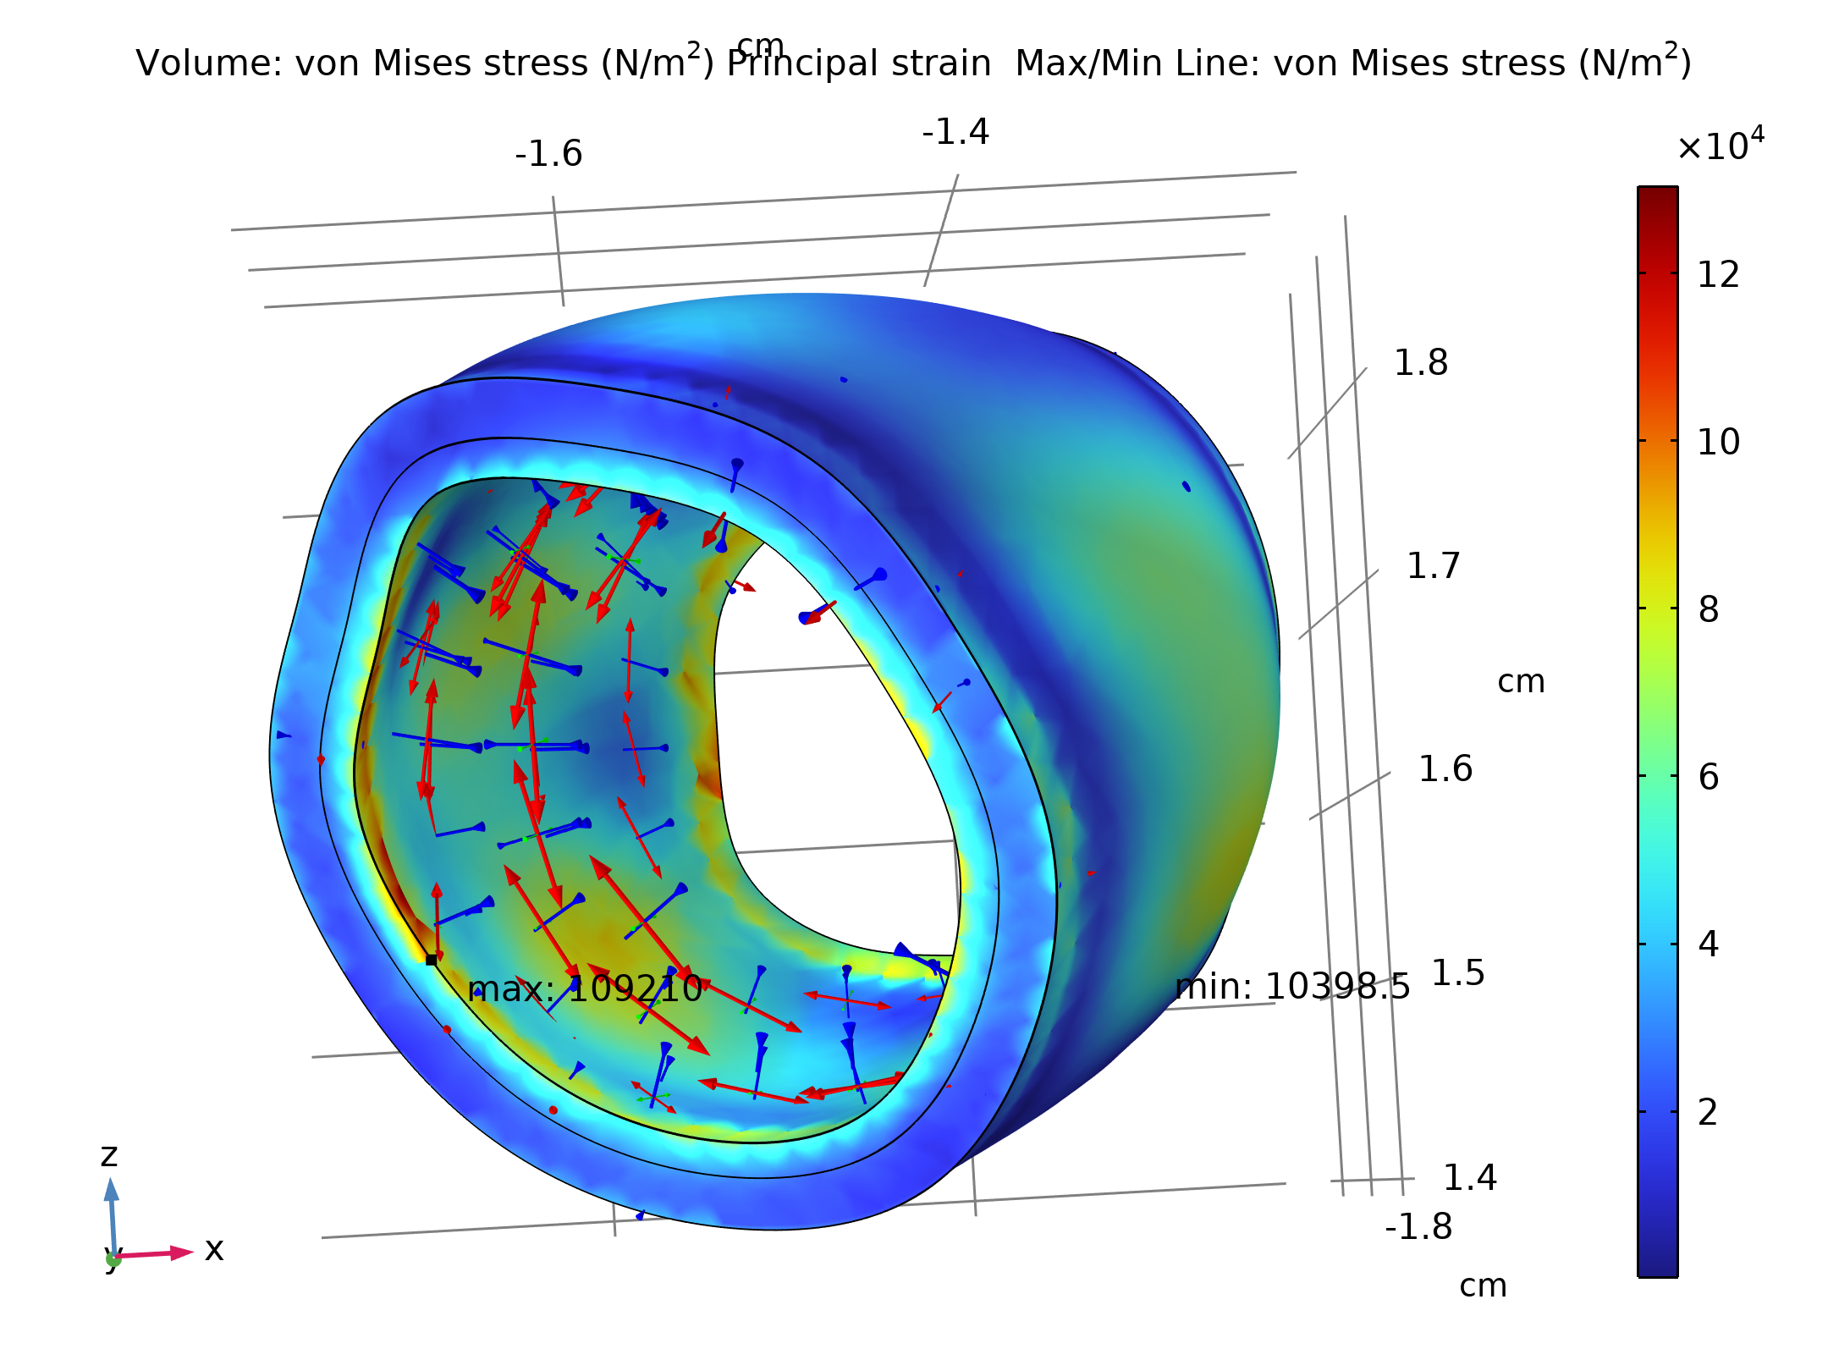
Strain Analysis – Systolic
For Boundary Load: 15,998.64 Pa
Max/min line
X | Y | Z | von Mises stress (N/m^2)
-1.3097 | -1.6389 | 1.5263 | 10398
-1.6851 | -1.8534 | 1.5402 | 1.0921E5
Volume: von Mises stress (N/m²) Principal strain Max/Min Line: von Mises stress (N/m²)

Slide 21
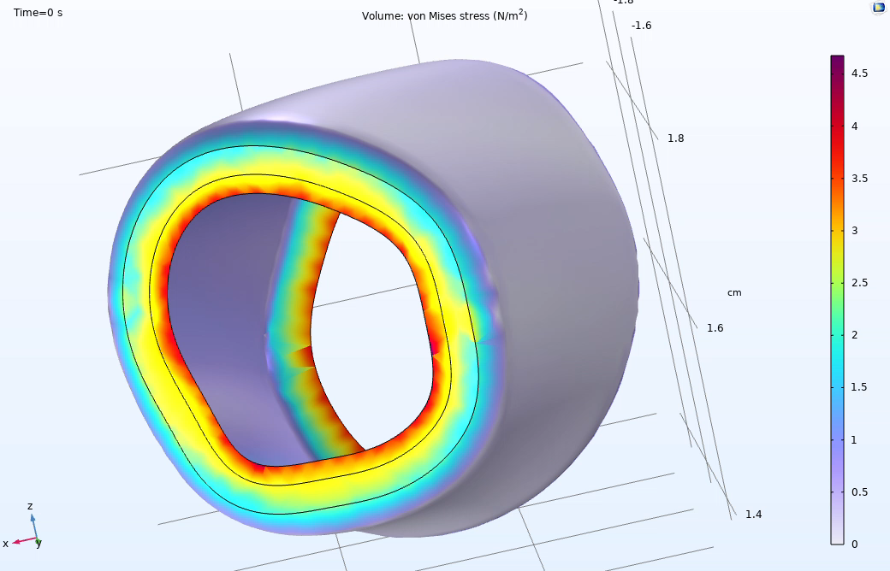
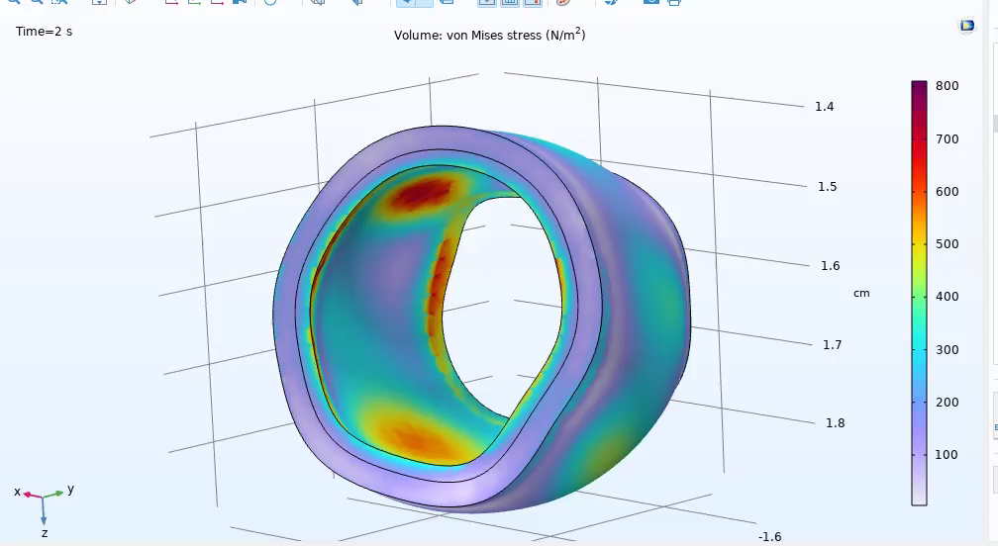
Result
Strain analysis of Diastolic pressure (80 mmHg): 80 × 133.322 = 10 , 665.76 Pa 80×133.322=10,665.76Pa
Strain analysis of Systolic pressure (120 mmHg): 120 × 133.322 = 15 , 998.64 Pa 120×133.322=15,998.64Pa

Slide 22
Result
Parameter | At 10,665.76 Pa (Diastolic Pressure) | At 15,998.64 Pa (Systolic Pressure) | Inference / Interpretation
Stress Type Observed | von Mises stress | von Mises stress | Both simulations used von Mises stress to evaluate material response
Stress Magnitude | Relatively low | Significantly higher | Arterial wall experiences greater internal stress during systole
Principal Strain | Low strain distribution | Higher strain values across wall layers | Indicates more arterial expansion during peak pressure
Stress Distribution | Uniform or mild gradient | Sharp stress gradients, especially near inner media | Suggests risk zones or mechanical stress concentration under high load
Material Behavior | Linearly elastic to mildly nonlinear | Strongly nonlinear hyper elastic response (HGO behavior evident) | Confirms importance of using HGO model for accurate tissue mechanics
Layer-wise Effect | Moderate deformation in media and adventitia layers | Higher deformation, especially in media layer | Media is more responsive to pressure changes due to its location and structure
Wall Expansion | Minor expansion of the arterial wall | Significant expansion under peak load | Physiologically accurate: arteries expand more during systole

Slide 23
Conclusion
Developed a detailed computational framework for simulating blood flow in a three-layered artery using COMSOL Multiphysics.
Created realistic 3D artery geometry in Blender, segmented into intima, media, and adventitia layers.
Applied the Holzapfel–Gasser–Ogden (HGO) model to represent anisotropic and hyper elastic arterial wall behavior.
Incorporated non-Newtonian blood properties and pulsatile pressure loading to reflect physiological conditions.
Accurately simulated laminar velocity profiles, pressure distribution, and wall stress-strain behavior.
Results confirm the anatomical accuracy and biomechanical realism of the arterial model.

Slide 24
Future Scope
Expand the model to simulate pathological conditions such as:
Arterial stenosis
Aneurysm formation
Chronic hypertension-induced changes
Integrate patient-specific imaging data to extract personalized arterial geometries.
Implement automated parameter fitting for case-specific material calibration.
Combine the simulation framework with:
Real-time biofeedback systems
Machine learning models for predictive diagnostics and risk assessment.
These advancements can contribute significantly to clinical decision support and personalized cardiovascular care.

Slide 25
THANK YOU

